Slide 1

Development Management
My recommended project management methodology for
Game development
Notes:
Hello my name is Lewis, In this video I will be discussing my recommended project management and data collection techniques for game development.

Slide 2
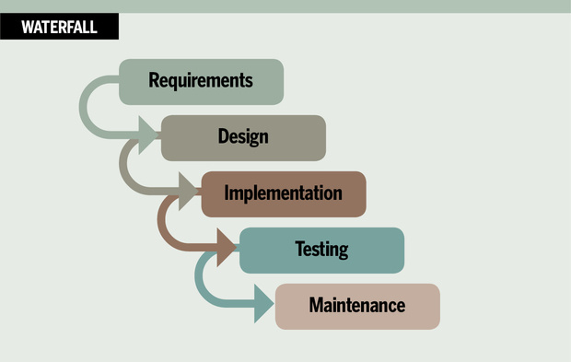




Traditional Development
Notes:
In traditional project management, the development process is divided into static phases, these phases comprise of
Analysis which list all requirements for the project, Design the project from requirements, Developing the mechanics, art and anything required for the project, Testing the product, Maintain
This is commonly known as the waterfall method.
These phases must be executed in this specific order, as it allows for increased control throughout each phase and offers a lot of formal planning before development is underway.

Slide 3
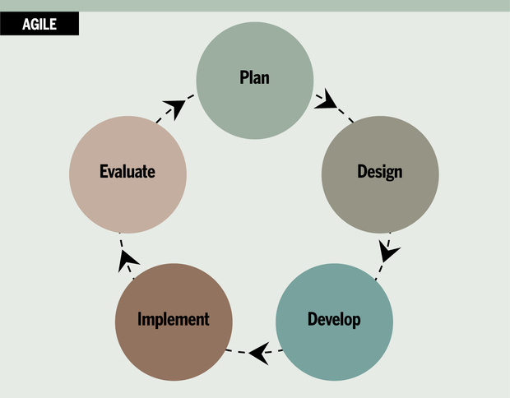




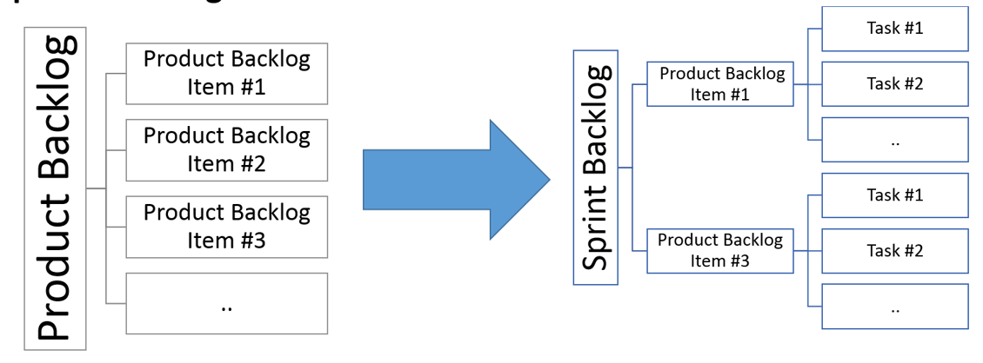
Agile Development
Notes:
Agile was created for projects that require significant flexibility and speed compared to more traditional management. Agile development follows an incremental and iterative development process and is highly flexible allowing for rapid adjustments throughout the project. Instead of massive planning like traditional methods, a project using agile will create a product backlog of tasks also known as story points that are prioritized in levels of importance, these tasks are then compiled in to a sprint that can last up to 4 weeks. After the sprint is complete the team will review the sprint process, at this point it allows the team to identify issues and improvements they can implement for the next sprint. In my opinion the agile development process is more suitable for game development. My recommendation for the development process is the combination of scrum and Extreme programming. But what are these methodologies

Slide 4
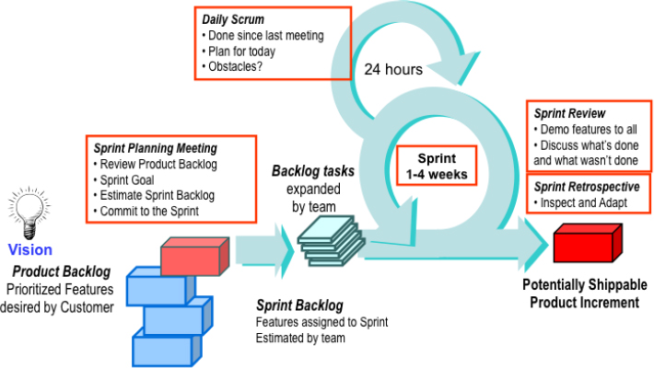
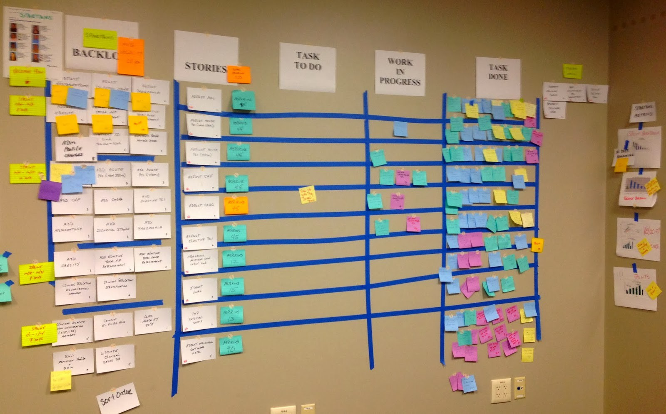
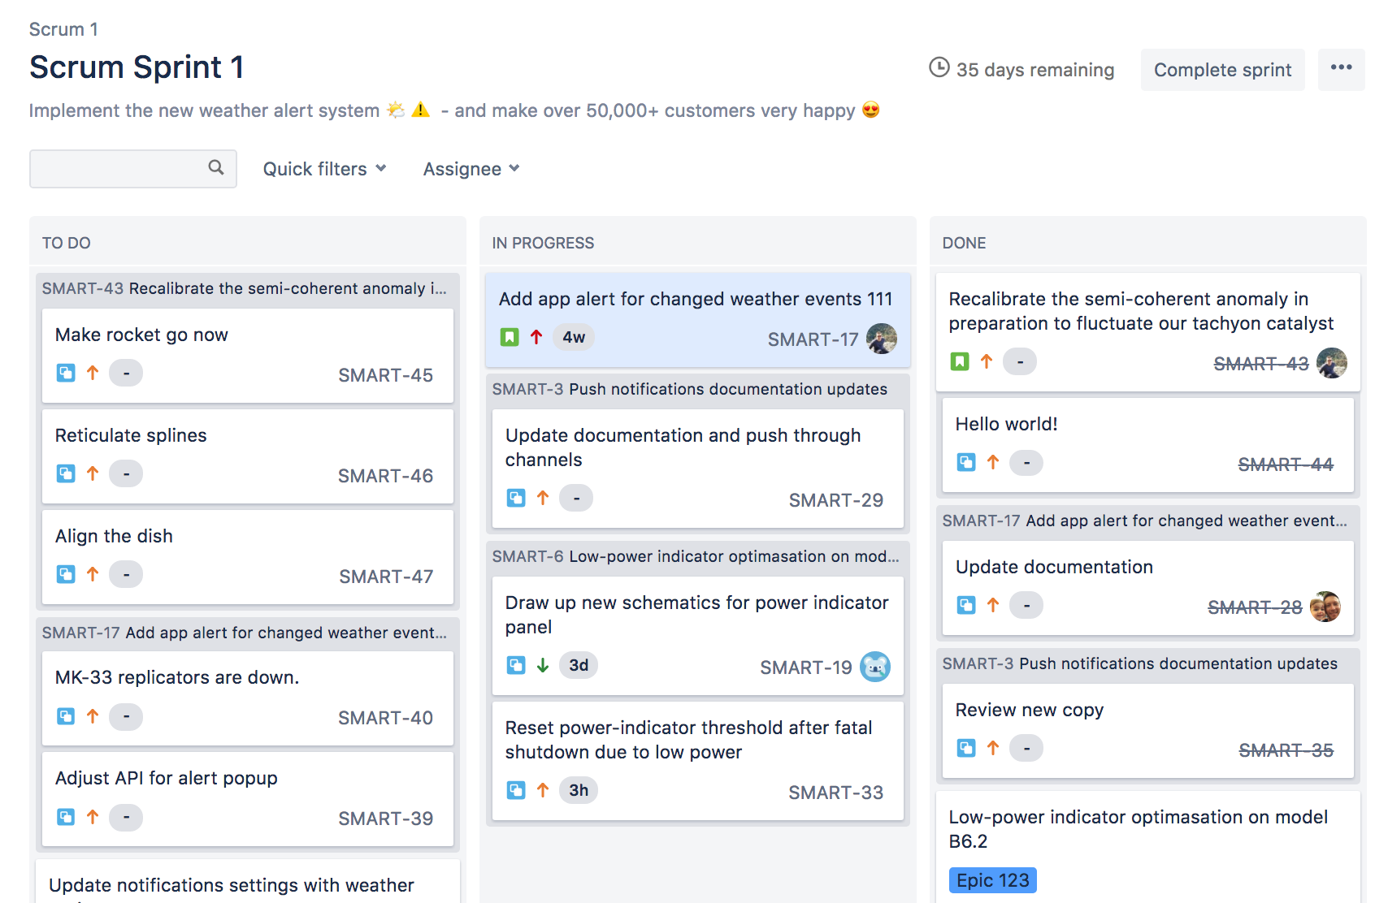
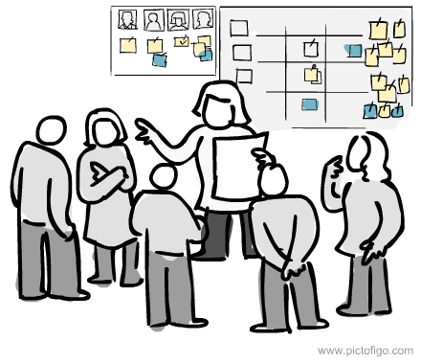
Scrum
Notes:
Scrum is an iterative development process that incorporates close cooperation between employees. A Unique characteristic of scrum is a daily stand-up meeting or scrum meeting, the meeting is run by a scrum master and will ask three main questions to the team members, What I did Yesterday? What I’ll do today? And What’s in my way? This gives each member of the team a chance to communicate and evaluate the current progress of the sprint, this allows for issues or problems to be discovered quickly and adjusted and gives the entire team all the data. This can increase the productivity of the team members as well as the quality of the work as it reduces the chance of failed sprints. Scrum also using scrum boards in which the team can track current in progress tasks and the backlog, these boards can be non-digital and digital

Slide 5
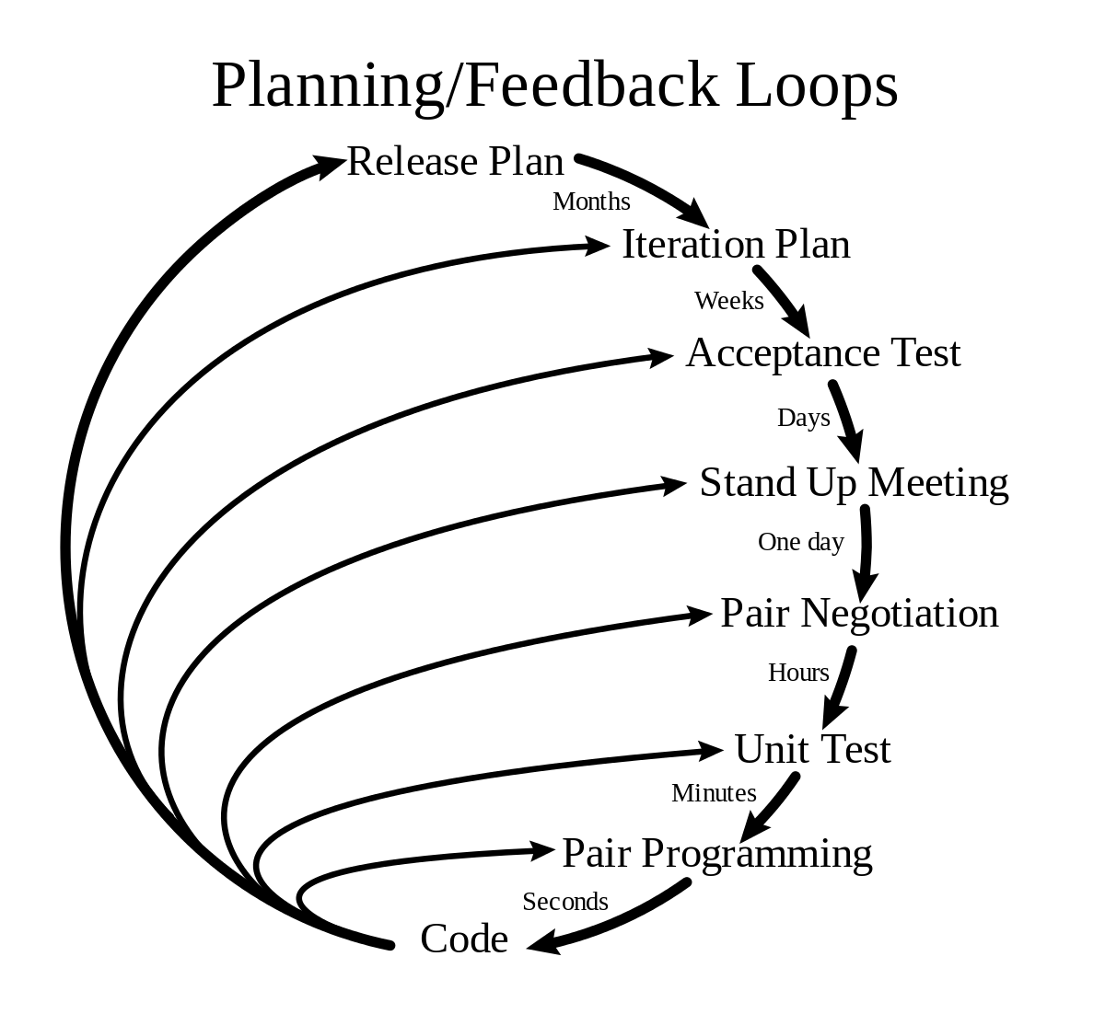
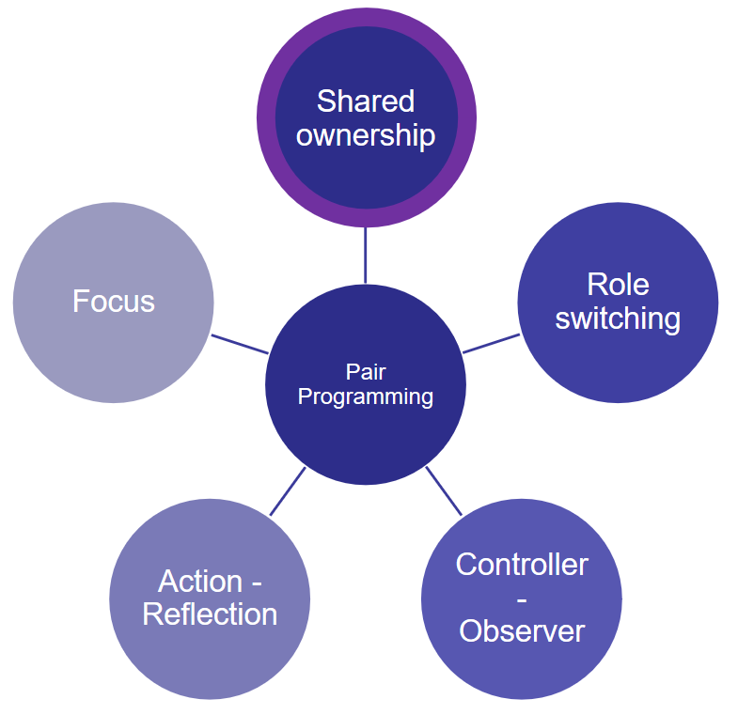



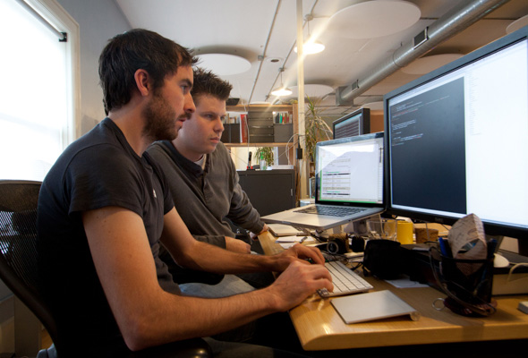

eXtreme Programming (XP)
Coach
Notes:
XP is a highly flexible agile based methodology that is used in the software development industry, the basis of XP development code-writing, test, iterate.
XP follows 5 values:
-Communication - Poor communication is the reason behind many project failures, this can occur between developers and customers. XP mitigates this by using a special role called a coach, a responsibility of a coach is to ensure good communication and detect any inconsistency in communication. Any issues with communication will be flagged up and the coach will investigate and try and fix it.
-Feedback- XP requires feedback at every development stage, this is to ensure that the project is exactly what the customer wants. The customer is constantly in the development process loop.
-Respect- Development teams work closely together during projects, XP values connection between employees that emphasises and improves teamwork.
_Courage- developer must have the courage to re-write, remove and change the code to ensure as many errors are removed, and the program is running as efficiently as possible.
-Simplicity- XP at tries to make the development process as simple as possible by only focusing on the most important aspect of the project, and not worrying about future addition/mechanics
XP also uses a simple and straightforward technique called Pair programming. Two programmers work side by side at one computer, continuously collaborating on the same design, code and testing. It allows two people to create higher quality work compared to solitary efforts. Other benefits reduced cycle time, enhanced learning with sharing of knowledge between both programmer, improve team work and relationship and overall 2 head's is better than 1.

Slide 6
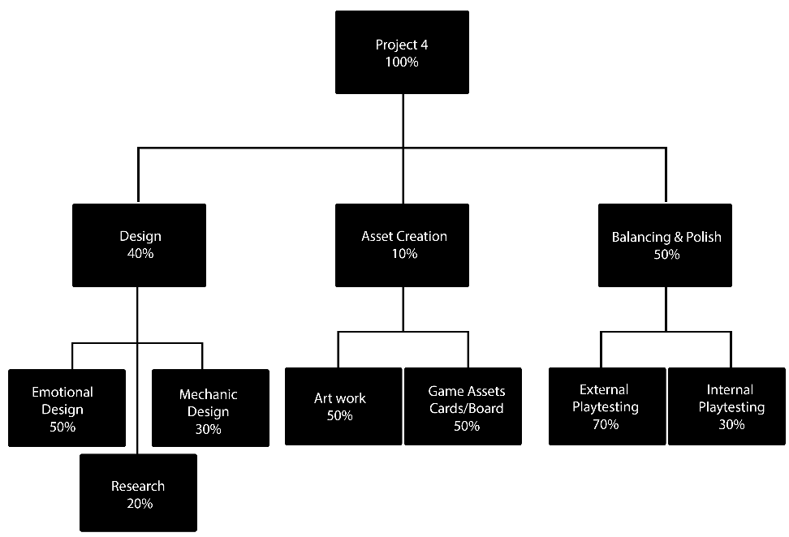
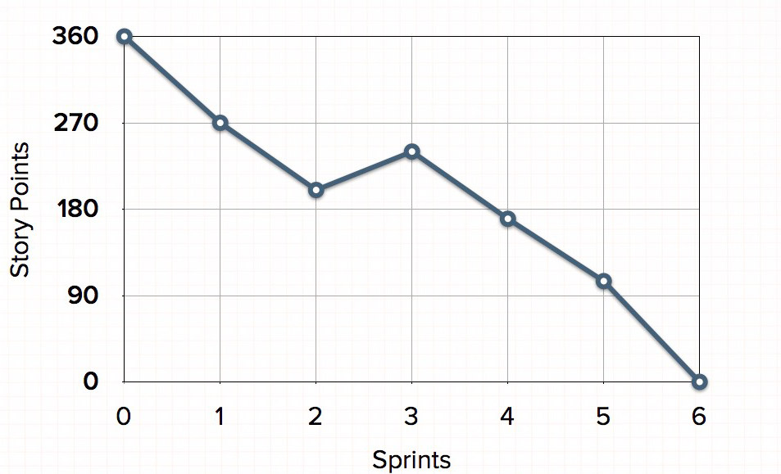
Tools
Likelihood | Impact | Combined | Risk
1 | 1 | 3 | No playtesters for the game
2 | 3 | 4 | Unable to achieve specific emotion
3 | 5 | 8 | 2 Week prototype goal
4 | 2 | 7 | Over scope
5 | 4 | 9 | Tools used in the project
Notes:
When using a combination of scrum and XP tools are need to aid the development process
A burndown chart is used to track the progress of a project, the chart is updated after every sprint. The burndown chart is an essential tool for an agile managed project and is a way for the team to visualize the progress level after each sprint.
A work breakdown structure allows the team to estimate the amount of time they are going to need for a specific task. To do this you take a single task and break it down into separate elements. You then estimate how long each of the separate tasks will take to make.
A risk assessment lets you see where projects need attention. Risk management practices let the team spot concerns far earlier. With risks being actively tracked and managed, the project team can maintain a focus on the critical outcomes. Risk management supports this because it serves to highlight where project outcomes may not be achieved, focusing the team on what to do about that particular concern to get the project back on track.

Slide 7
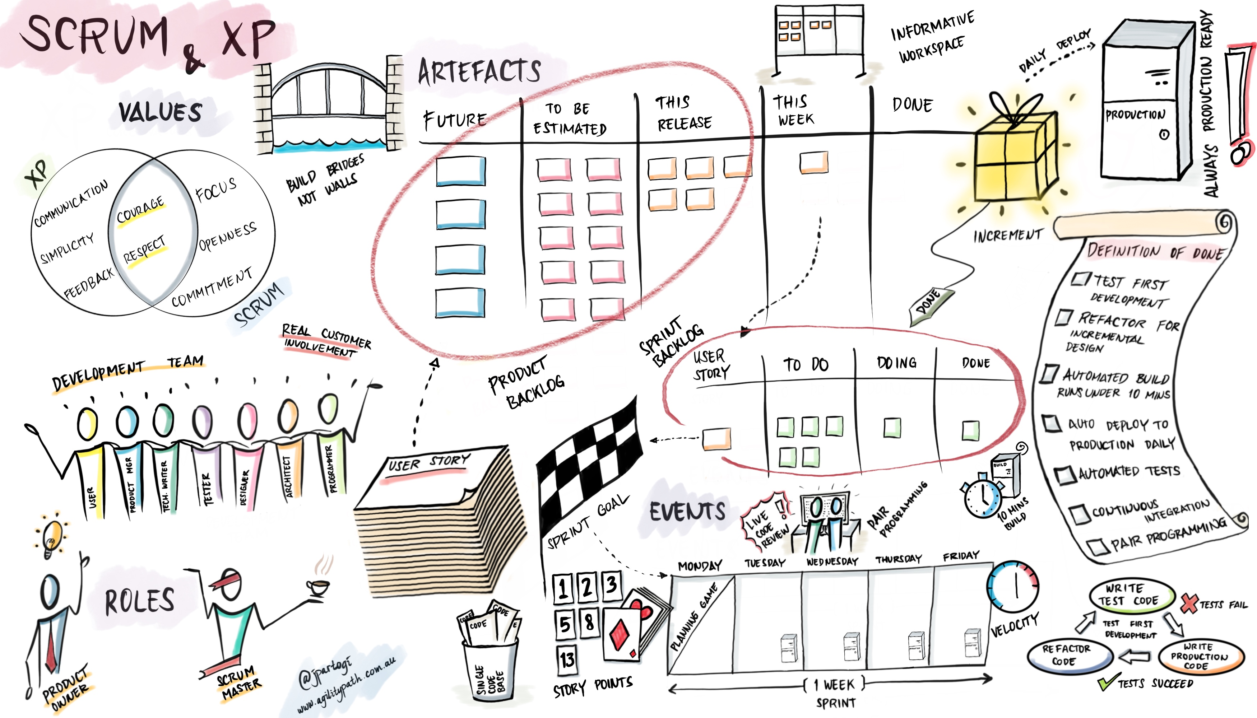
Recommended Method
Notes:
Both agile and traditional methodologies have their advantages and disadvantages, however in relation to game development agile supports key factors for development.
Traditional methodologies support vast documentation and accountability for a project, however, within game development, the constant changes in hardware and customer requirements make it difficult to maintain this.
My recommendation for project management within the game industry, would be to combine Scrum and Extreme programming as discussed before. I would implement Scrum in its entirety but also include aspect from extreme programming, Pair programming would be an easy aspect to implement as digital games require forms of programming. However you could adjust pair programming to the projects needs, instead of having 2 programmers together, pair up a programmer and a tester, this allows for constant testing as the programmer is writing the code. Another aspect I would add to scrum is the coach roll, the issue with a scrum master is they are not required to have any technical knowledge. A coach on the other hand is a part of the development team and technical knowledge is a requirement. The coach will also aid is communication efficiency and makes sure both the customer and the dev team are communicating at their best.
This method focuses on
Communication
Teamwork
Improve product quality

